Slide 1
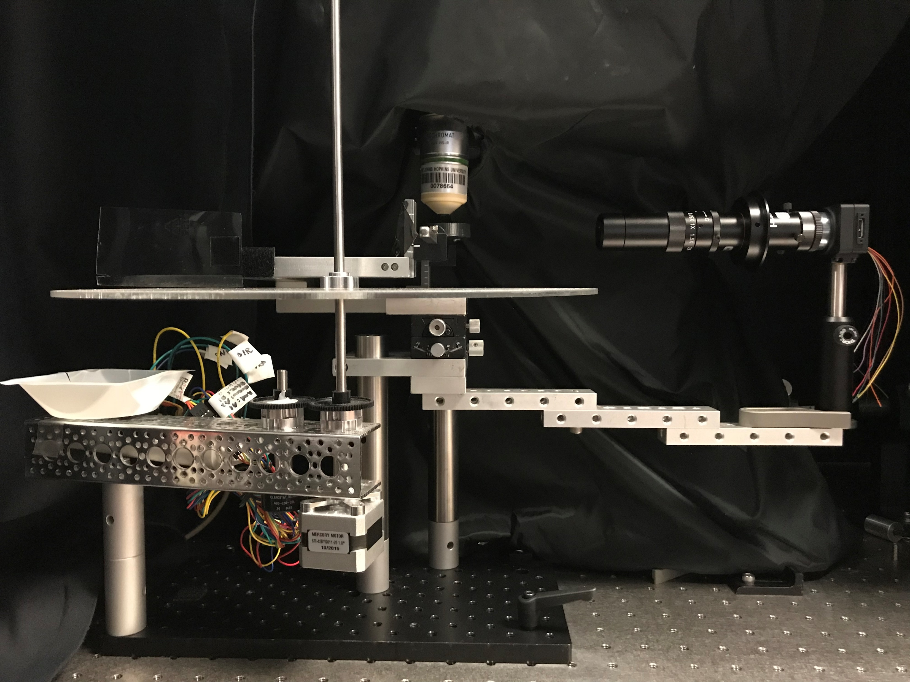
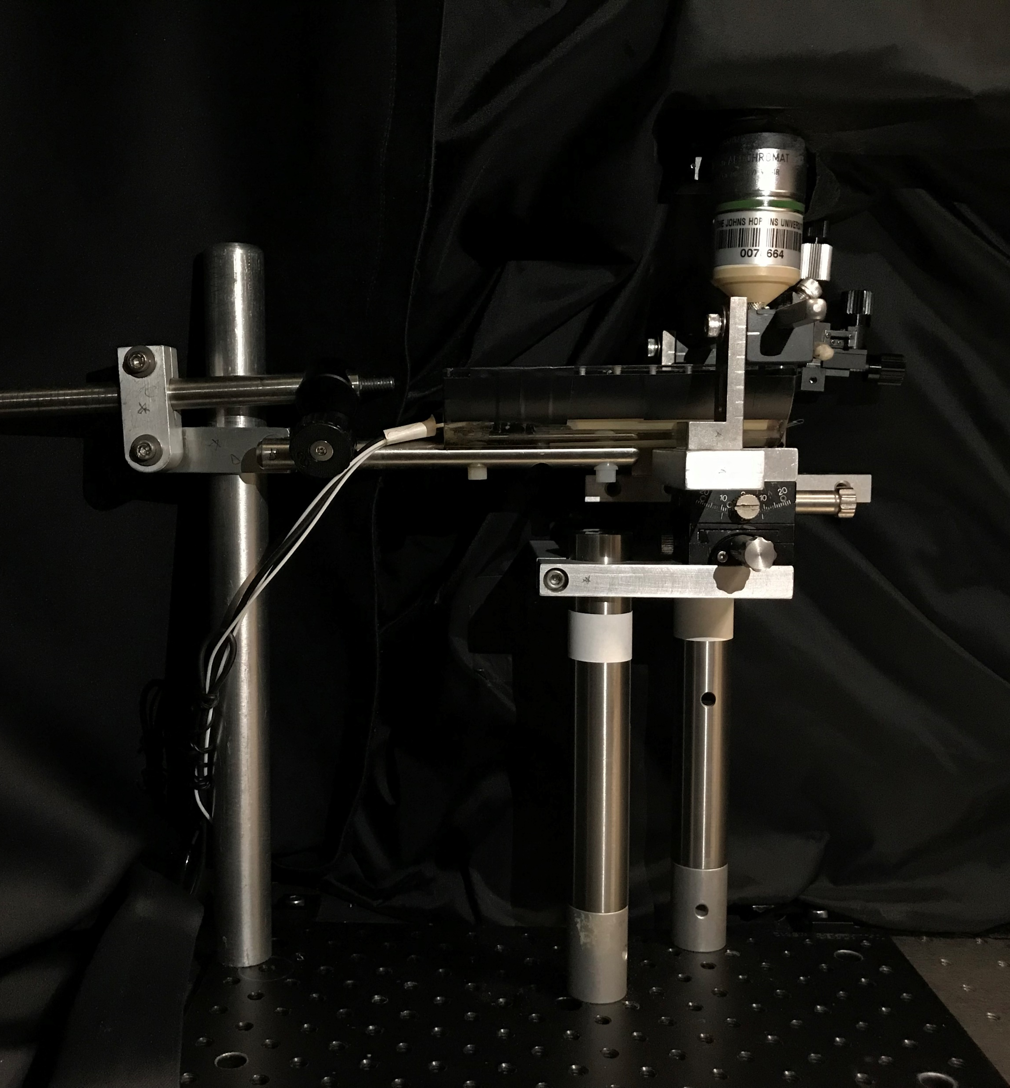
Headbar Platform 1
Headbar Platform 2
Anesthesia Tube
Circular Treadmill
Microscope Objective
Eyetracker
Camera
Bar Clamp 2
Plastic Sheet
Zoom Lens
Bar Clamp 1
a
b
Post Holder (PH3)
RS2
Clamping Fork (125)
RS1
Stool
collection
Stepper Motor
Baseplate
RS6
Gonio Square
9" Channel
Gears
Goniometers
Goniometer Platform

Slide 2
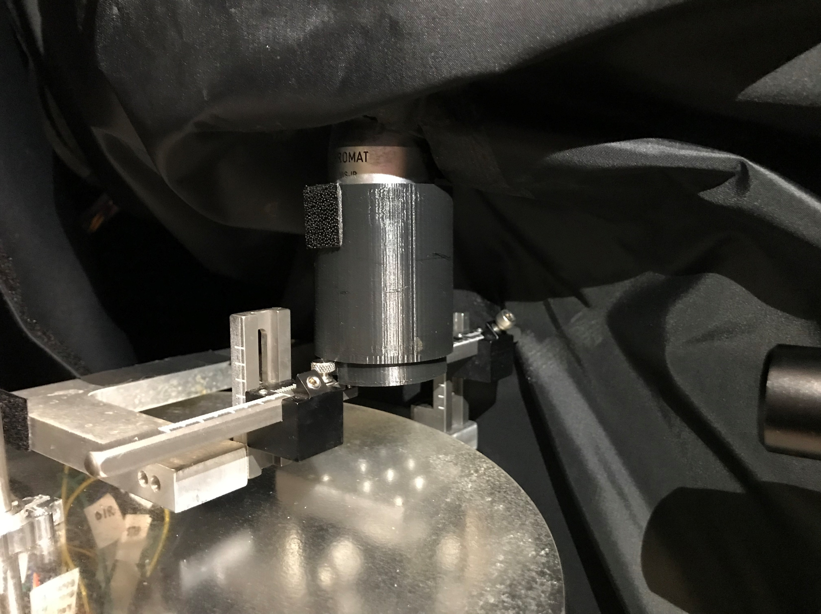
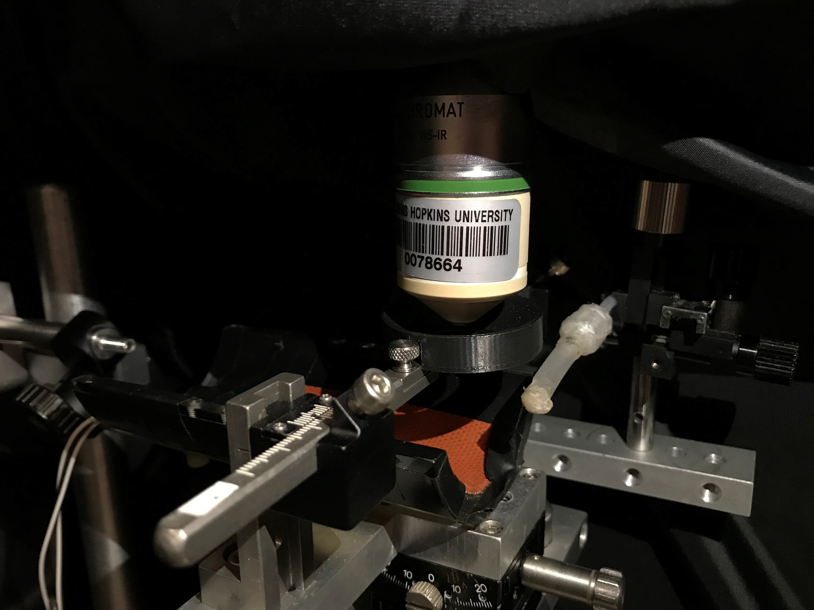
Light Proofing-Cylinder
Microscope Objective
a
b
Light Proofing-Crown
Anesthesia Tube
Bar Rest
Headbar Post
Headbar
Headbar Platform 1
Headbar Platform 2

